Slide 1


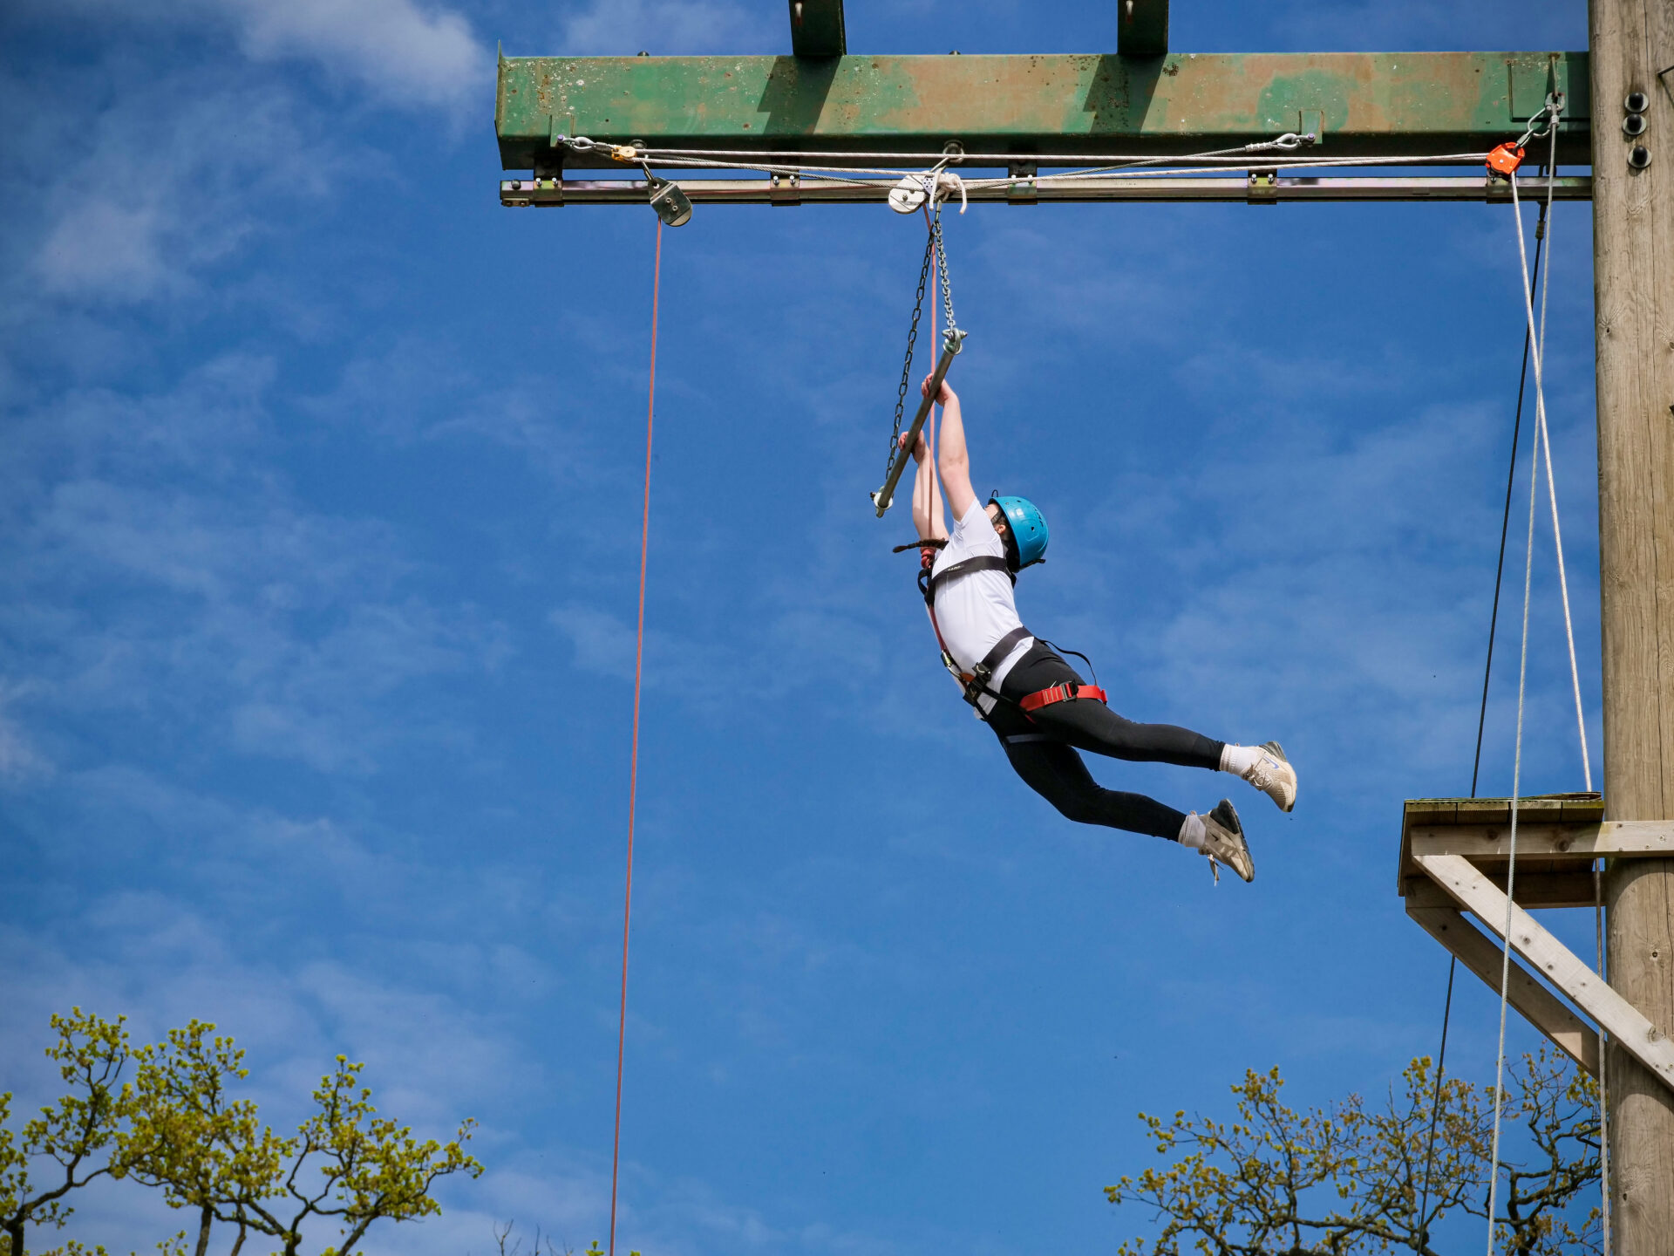
CONDOVER HALL RESIDENTIAL
Friday 16th –Sunday 18th October 2026

Slide 2


Slide 3
https://www.jca-adventure.co.uk/parents-hub/
All of the following information can also be found on the schools website using the following link.
https://www.downside-primary.co.uk/Year-5-Condover-Hall/
Emergency Contact: Condover Hall 01743 874932

Slide 4
Itinerary
Friday 16th October
Arrive at school 8:45am and drop luggage into the family room.*
Children to come to school in active wear- ready for the first activity!
Children will then register in class as normal and spend the morning in class.
All children will have lunch at school.
1:30pm board the minibus and depart school around1:15pm
Journey is approximately 2hrs 15min so arrive at venue at 3:30pm.
Sunday 18th October
Pack up and leave venue at 1:30pm and get back to school at 4pm*
(All children must be collected by an adult)

Slide 5
Itinerary at venue
All activities are run by qualified JCA members of staff and follow all safety guidance and rules.
Downside staff will be with the children at all times.
All activities are challenge by choice meaning that children are given the opportunity to participate to a level they feel comfortable.
Please ensure that you child has a named water bottle and will need a long sleeve top and coat for all activities.
Although we will put children in their groups we will ensure that they are with friends. It will be mixed groups.
Between 8:45pm and 9am the next morning staff will be looked after by Downside staff.
The children are NOT doing any water activities- so will not need any swimming kit.
Activity Session Times
• Morning Session One: 9am-10.30am
• Morning Session Two: 10.45am-12.15pm
• Afternoon Session Three: 2pm-3.30pm
• Afternoon Session Four: 3.45pm-5.15pm
• Evening Session: 7.15pm-8.45pm

Slide 6
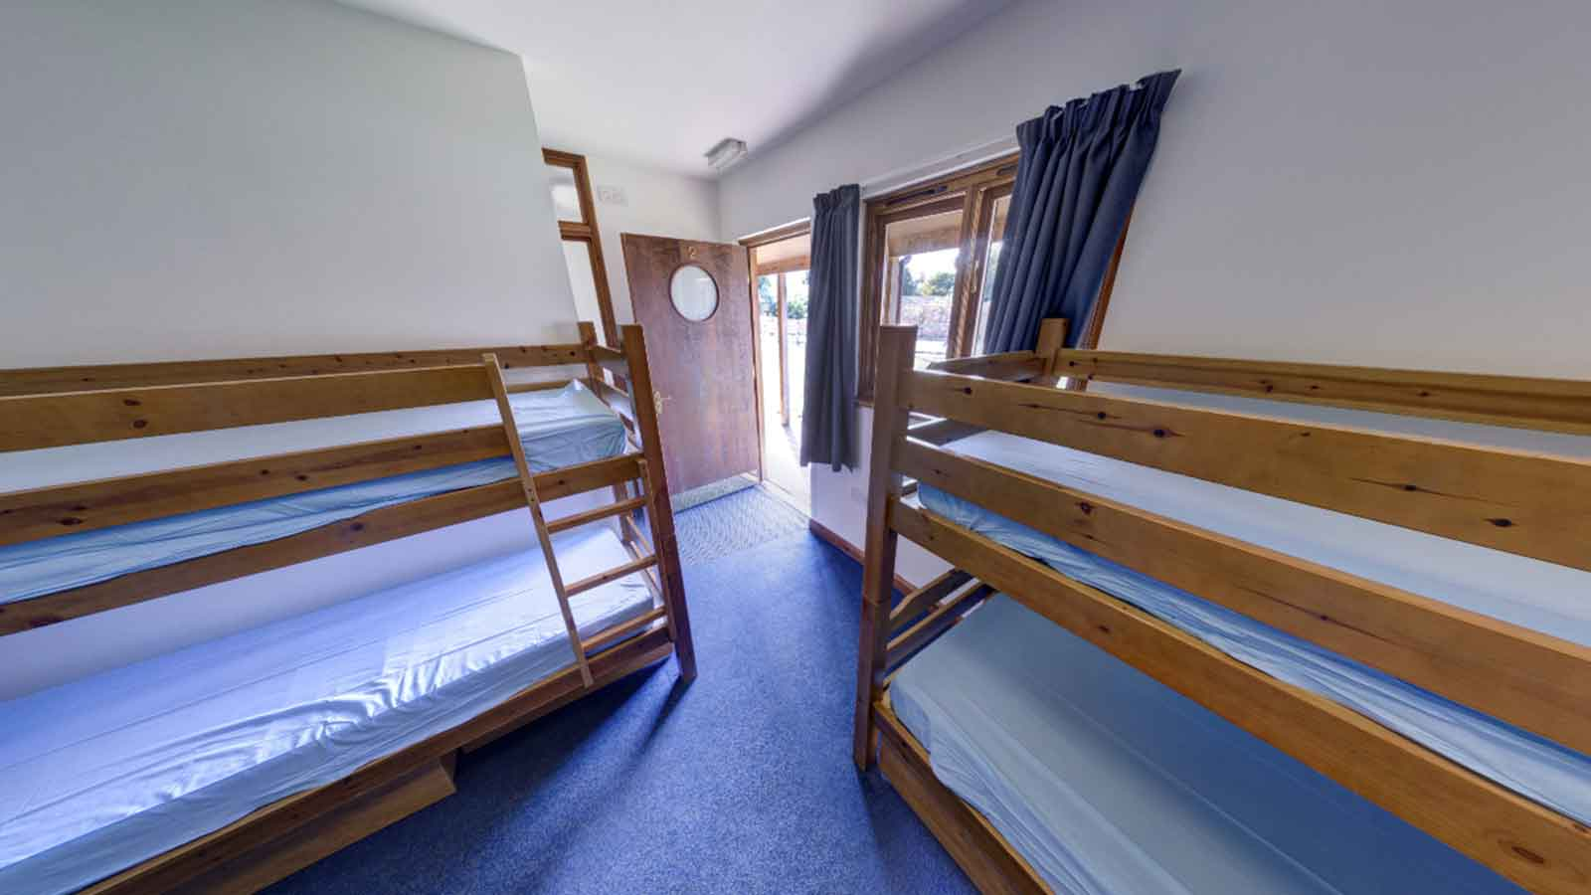
Accommodation
Children will sleep in all boys or girls dorms of between 8-10 beds.
All dorms are en-suite.
Teachers are in separate dorms at the end of each corridor.
Bedding*

Slide 7
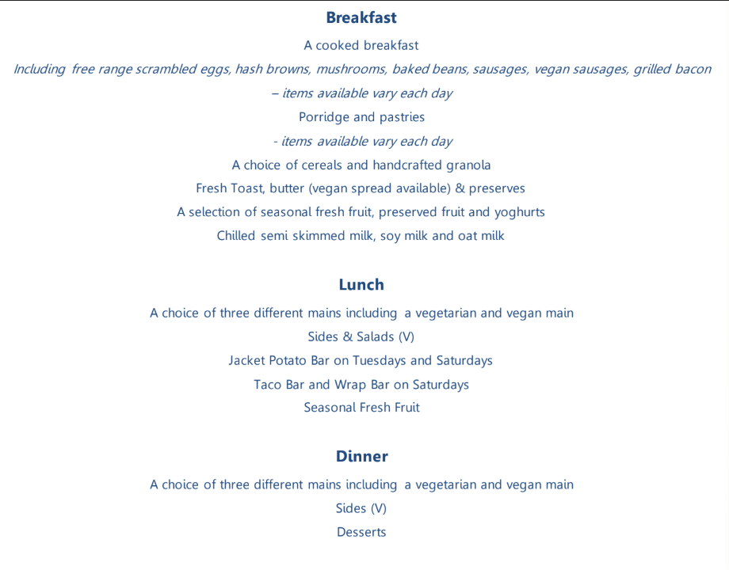
Food
The children will not go hungry! Please do not pack them any snacks.
All dietary/religious needs are covered by JCA and there is a wide range of vegetarian/vegan meals.

Slide 8
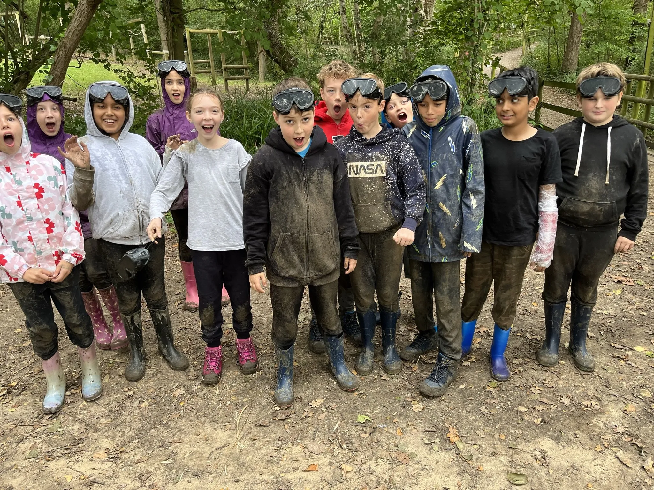
Kit list
Keep the bags small!* Keep the bags small!!*
The children will get muddy and dirty- avoid new clothes, expensive clothes, white!!!
Old or cheap trainers
Please follow the attached kit list
Please name all clothing.
A named water bottle
No devices, mobile phones, no smart watches!

Slide 9
Additional Information
No news, is good news! We will update the schools twitter and Facebook page during the weekend- when we can!!!
Your child will only need £10 spending money. Children will be responsible for their own money so please put in a small purse/money bag.
Birthdays.
Medication:
  If your child requires needs any medication over the weekend please bring this with you on the Friday morning and give to Mr Martin. (an additional form will be sent out before we leave)
Keep those bags small!
Contact information
Any other questions?

